Slide 1

Blackwell Adventure 2026
3-5th June
Parents’ Information Evening
Notes:
Nick to introduce – going as a whole year group for the first time.

Slide 2
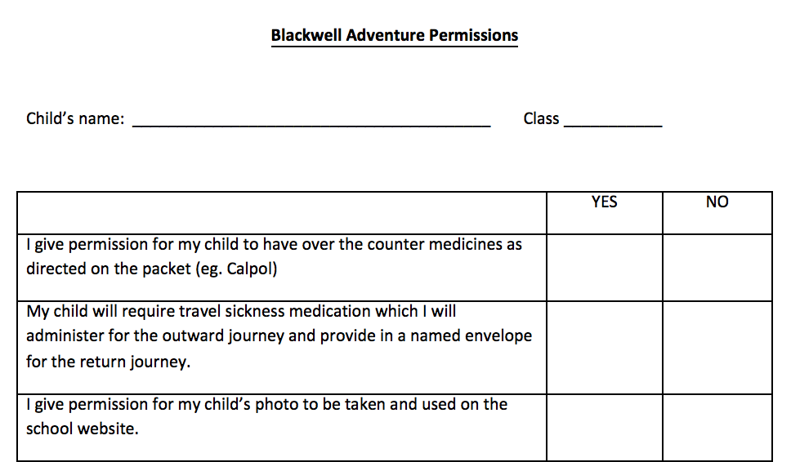
Consent Form/Information Pack
Please could these be completed and handed in at the end of this evening.
If school already has a care plan for your child’s medical condition, please just indicate this in the relevant box (there is no need to re-write information stated in the care plan).
Notes:
Nick

Slide 3
Staffing
Kerry Pope
Liz Munday
Marianne Halford
Beth Burrows
Joseph Lingard
Vicky Woodhead
Sara Hancock
Rebecca Travis
Jordan Thompson
Emma Bryant
Kat Turner
Notes:
Nick – a range of trusted adults

Slide 4
Departure/Arriving Back
Wednesday - Departure
Drop off as usual
Medication to be brought into school and handed to the class teacher
Depart from St Nicholas car park at 12pm approx.
Friday - Arrival
- Return to school at 4.45pm
Collect from St Nicholas Park
All children need to bring a packed lunch a snack and water bottle with them on the day they are departing for Blackwell Adventure.
Parents/carers are welcome to come and wave the children off at St Nicholas car park
Notes:
Kerry

Slide 5
Medicines
Travel Sickness Medication
If your child requires travel sickness medication:
Wednesday morning - bring in medication for outward and return journey in a named envelope to be handed in to your child's class teacher.
Other Medications
If your child has medication already in school, we will take this with us.
Any additional medication needed for the trip should be brought into school on the morning of departure in a named bag and handed to your child's class teacher.
Please ensure that any medication needed for the trip has been added to the signed consent form.
Notes:
Kerry

Slide 6
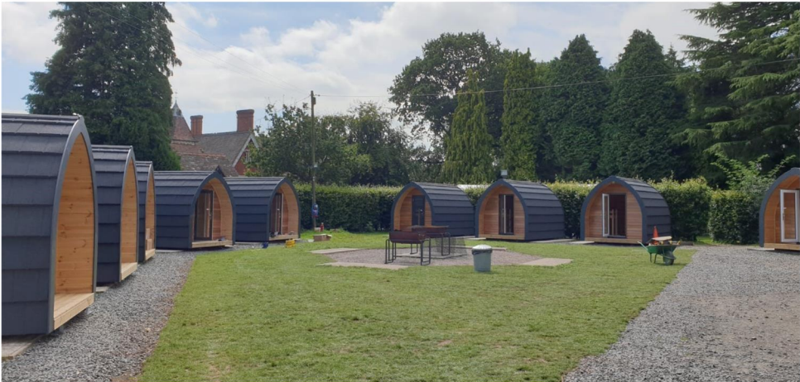
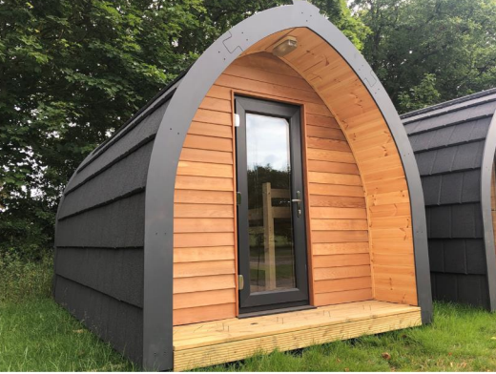
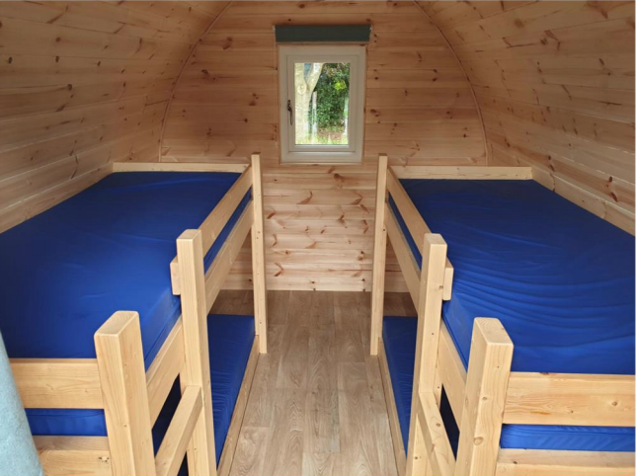
Accommodation- Roberts Podded Village – 4VW and ½ of 4JL
3 or 4 children per pod
Electric lights in all pods
Sleeping bag and pillow need to be brought as not provided (see kit list)
Mrs Pope
Mrs Travis
Mrs Woodhead
Mr Thompson
Mrs Hancock
Notes:
Nick

Slide 7
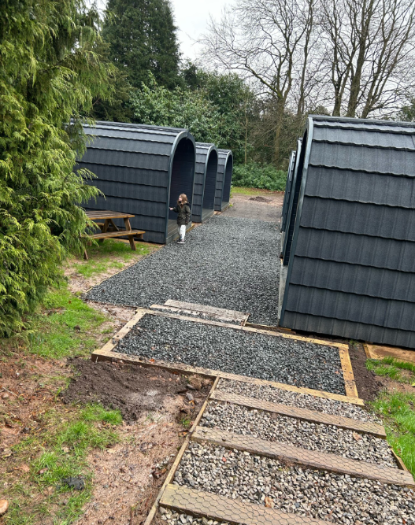
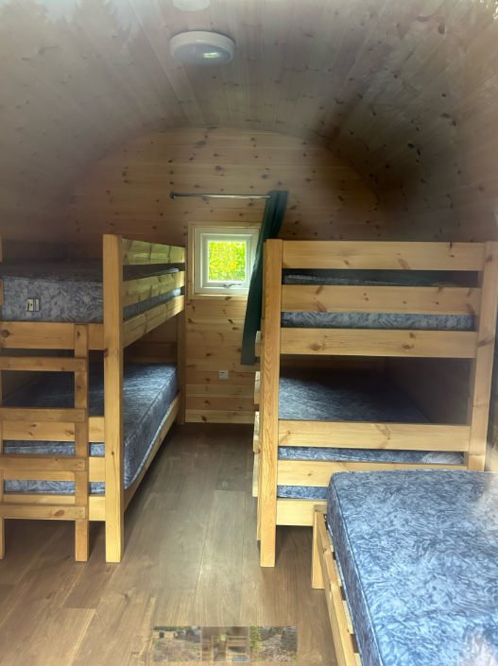
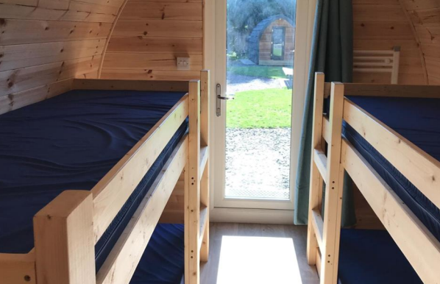
Accommodation – Yorkswood Pod Village
4BB and ½ of 4JL
Up to 5 children per pod
Electric lights in all pods
Sleeping bag and pillow need to be brought as not provided (see kit list)
Mrs Bryant
Miss Burrows
Mr Lingard
Mrs Munday
Mrs Halford
Mrs. Turner
Notes:
Nick – dorms – children to select 3 names – we guarantee 1.

Slide 8

Behaviour
It is a small space for 4/5 people!
Personal space
Keeping tidy
Moving around the space carefully
Lights out
Going quietly to the toilet
Bed time
Be Safe;
Be Respectful
If necessary, we will contact
parents if we have concerns
about unsafe behaviours.
Notes:
High expectations of behaviour in dorms – children do not spend much time in them – be safe, be respectful

Slide 9
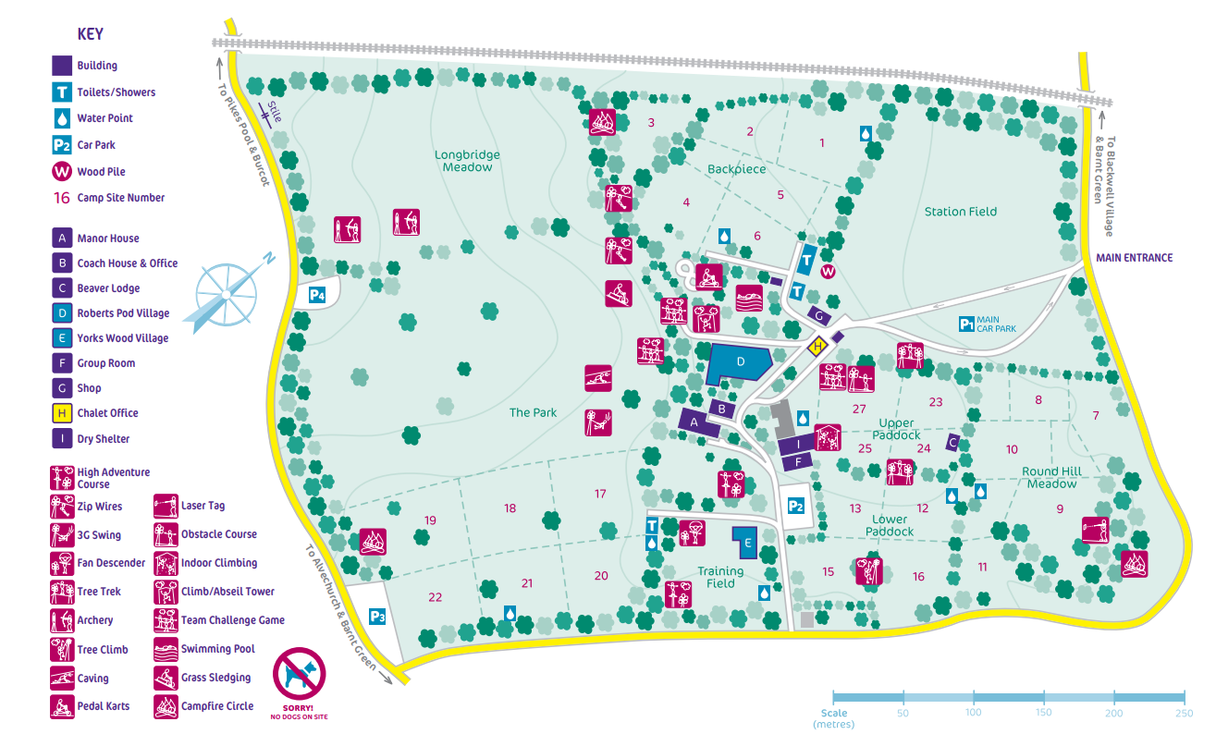
Very short walk (2 minutes) between the two pod villages marked in red.
30 second walk from pod village to toilet/shower units – marked in blue
Notes:
Nick

Slide 10
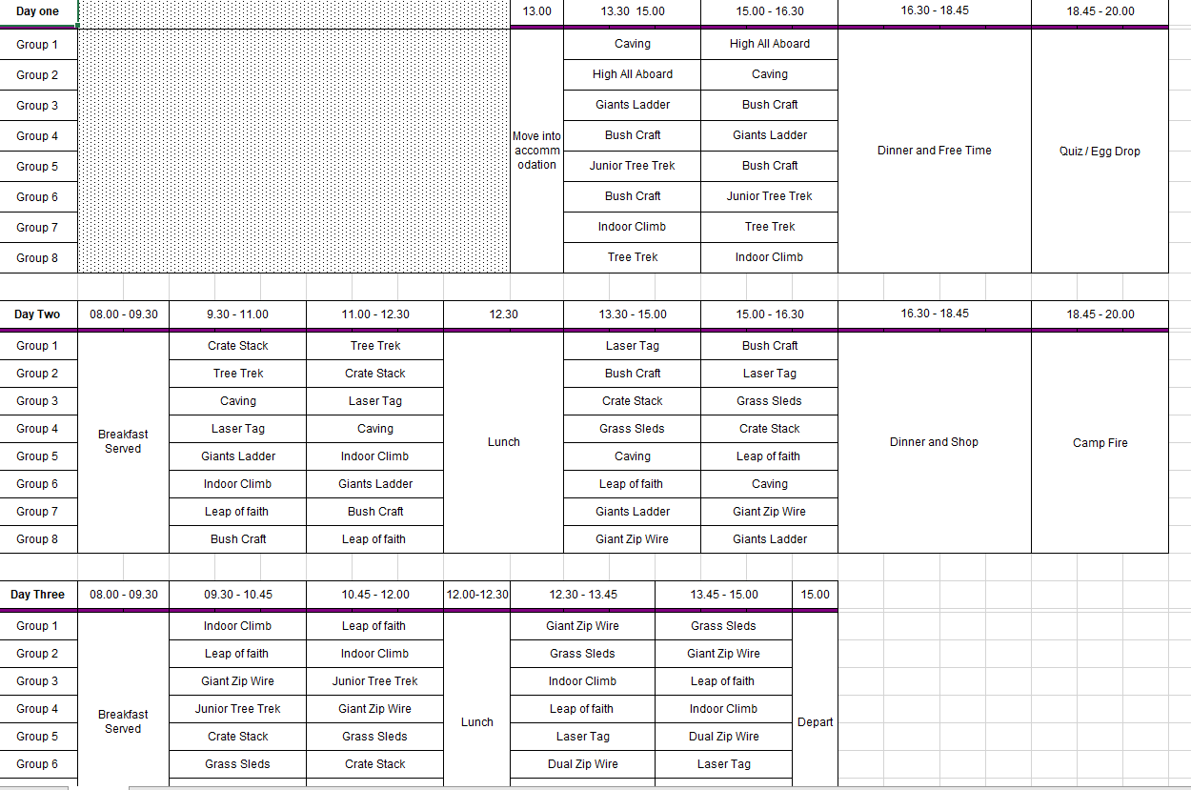
Structure of a day
Notes:
Nick – reduction in number of activities involving height

Slide 11
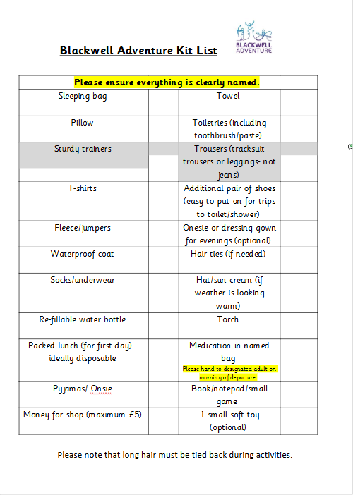
Kit List
Please take a copy of the kit list home with you.
Enough clothing for the 3 days. Comfortable for being active. Bring 1 or 2 spares in case we get wet!
Clothes for all weathers (warm and cold) - layers
Trainers for activities in the day but another pair of shoes for evening/trips to toilet would be useful.
Children will need to be able to carry and re-pack their own bags.
A small back pack in addition to main bag would be useful for water bottle/lunch.
Please do not bring any electronic items including phones, smart watches, fitbits or tablets.
Notes:
Kerry

Slide 12
Preparation
We are aware that this may be the first trip away from home for some children. Staff will be able to help children with organising themselves for the each day. However, it would be helpful if your child can confidently do the following independently:
- Tying shoelaces
- Tying up hair/general personal hygiene
- Packing bag
- Making their bed
- Folding and putting away clothes (limited space in the pods)
- Trying different foods
- Applying sun cream (if needed)
- Carrying own bag/belongings
- sleepover away from home
Notes:
Kerry – talk about food here

Slide 13
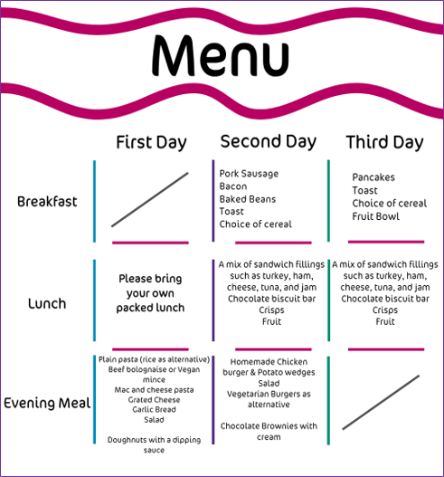

Slide 14
Please speak to your child’s class teacher about any concerns or questions if you would prefer not to ask today.
Any Questions?

