Slide 1



Home learning ideas for Keller students!
Keller

Slide 2

Task 1

Slide 3
Silky Soft Playdoh
You will need
8 tbsp plain flour
2 tbsp table salt
60ml warm water
food colouring
1 tbsp vegetable oil
Method
1. Mix the flour and salt in a large bowl. In a separate bowl mix together the water, a few drops of food colouring and the oil.
2. Pour the coloured water into the flour mix and bring together with a spoon.
3. Dust a work surface with a little flour and turn out the dough. Knead together for a few minutes to form a smooth, pliable dough. If you want a more intense colour you can work in a few extra drops of food colouring.
4. Store in a plastic sandwich bag (squeeze out the air) in the fridge to keep it fresh
For lots more sensory playdoh ideas and recipes take a look at the twinkl website! (https://www.twinkl.co.uk/search?term=playdough+recipe)

Slide 4

Task 2

Slide 5

Sensory stories
Choosing a story
Try to find a story/book that has lots of repetition, actions and excitement to it.
In class we enjoy reading the same story over and over again so that we can really begin to understand it and anticipate what is going to happen next.
Incorporate lots of actions, signs and maybe even props to create a fun sensory story!

Slide 6
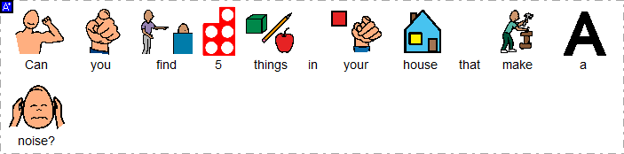

Task 3

Slide 7
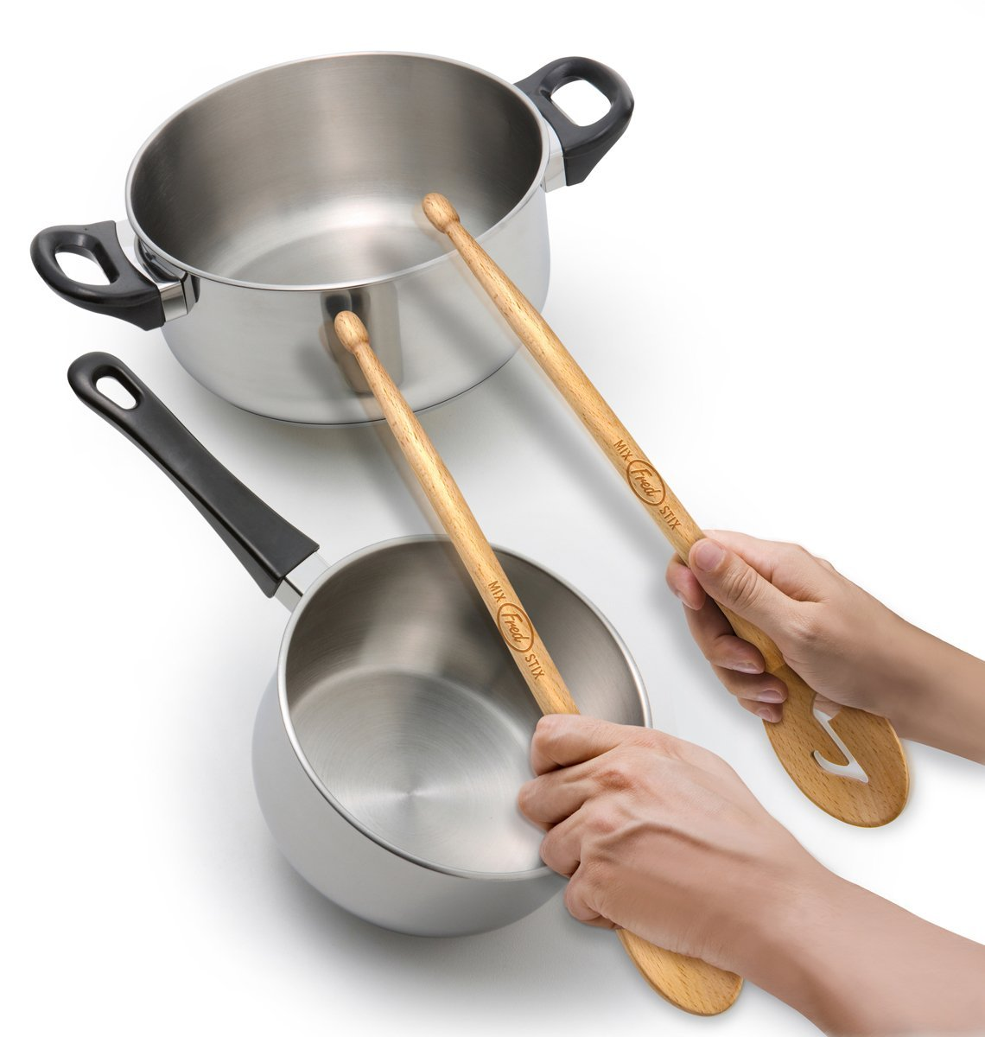
Sounds
Making noise and exploring sound
Explore everything around you!
Make fun with house hold utensils and objects, for example, students can work on their fine motor skills by being presented with a range of different objects – can they pick them up and drop them on the floor? Which one is the loudest?
Can they hold one object and hit it onto another, for example, using sticks or wooden spoons and hitting them onto pans to make sounds?

Slide 8

Task 4

Slide 9
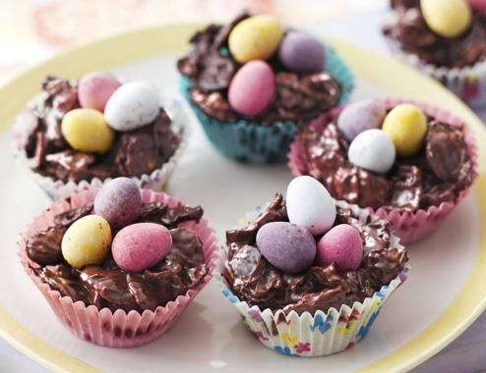
Chocolate Easter egg nest cakes
As Easer is approaching we had some exciting recipes we were planning on following in our cooking lessons at school, here’s a easy one to follow at home.
Ingredients
225g/8oz plain chocolate, broken into pieces
2 tbsp golden syrup
50g/2oz butter
75g/3oz cornflakes
36 mini chocolate eggs
Method
Line a 12-hole fairy cake tin with paper cases.
Melt the chocolate, golden syrup and butter in a bowl set over a pan of gently simmering water, (do not let the base of the bowl touch the water). Stir the mixture until smooth.
Remove the bowl from the heat and gently stir in the cornflakes until all of the cereal is coated in the chocolate.
Divide the mixture between the paper cases and press 3 chocolate eggs into the centre of each nest. Chill in the fridge for 1 hour, or until completely set.

Slide 10
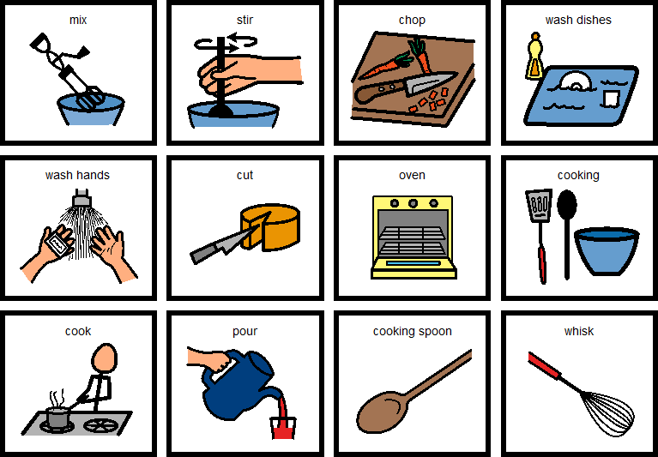
Symbols to support language.

Slide 11

Task 5

Slide 12

Movement
Stretching
Wherever possible spend lots of time moving, stretching, dancing and having fun!
At school we have lots of time using various pieces of equipment and on the mats. Whilst on the mats we enjoy playing instruments, exploring sensory objects and lights and playing games together.
We always begin our school day with a song called ‘Busy Body’ as part of our morning routine. Please enjoy this at home and stretch each part of your body along with the song and with family.
You will be able to find the song on youtube. It’s called ‘Busy Body’ by ‘Sing and Grow’. The link to song is https://www.youtube.com/watch?v=TOAcdbDFjGo.

Slide 13
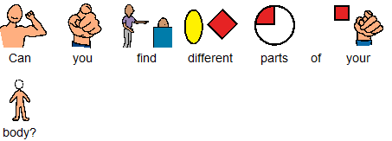
Task 6

Slide 14
Simon Says
Body awareness
At home enjoy some fun interacting games with family members. A favourite at school is ‘Simon says’ (or you can use any name e.g. ‘mum says’, ‘Eliza says’ etc). This is another fun way we can work on our stretching.
Either independently or with support try....
Touch your nose
Touch your ears
Clap your hands
Touch or eye point to your feet
Make a noise
Touch the top of your head
Give someone a high five
Etc.

Slide 15
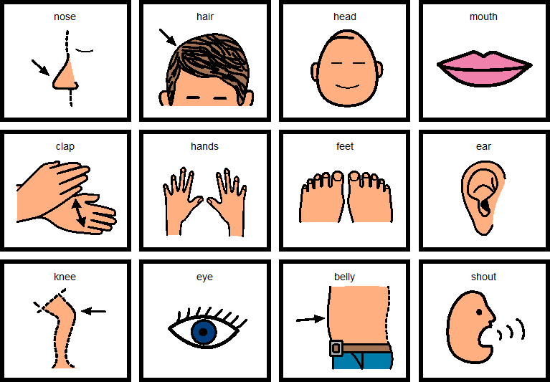
Symbols to support language.

Slide 16

Task 7

Slide 17
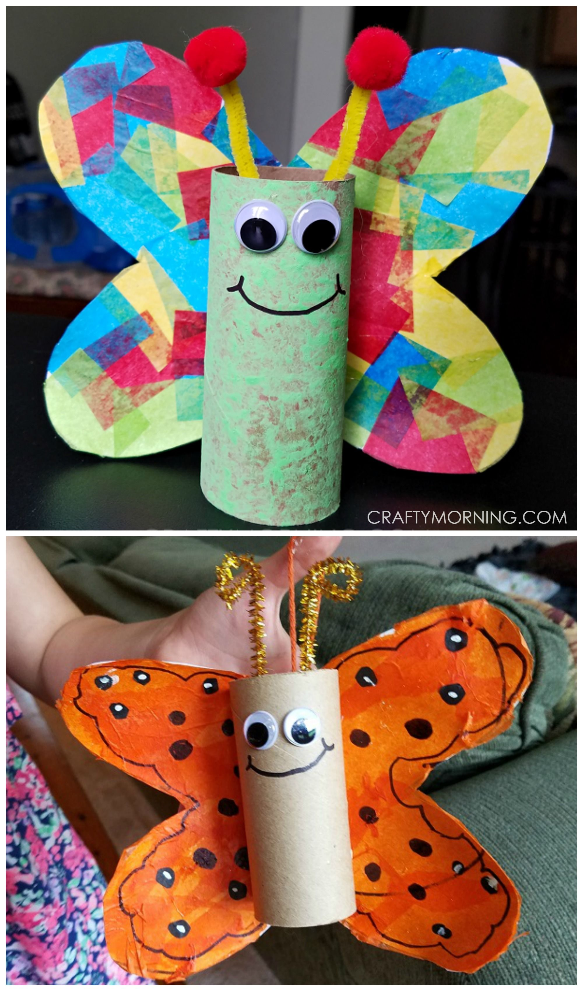
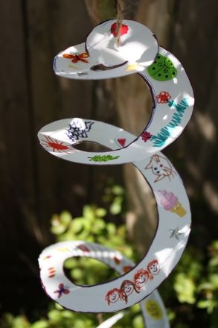
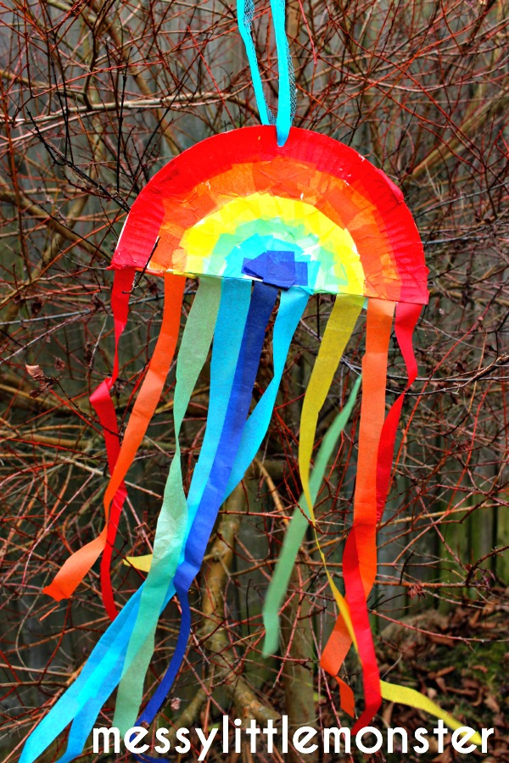
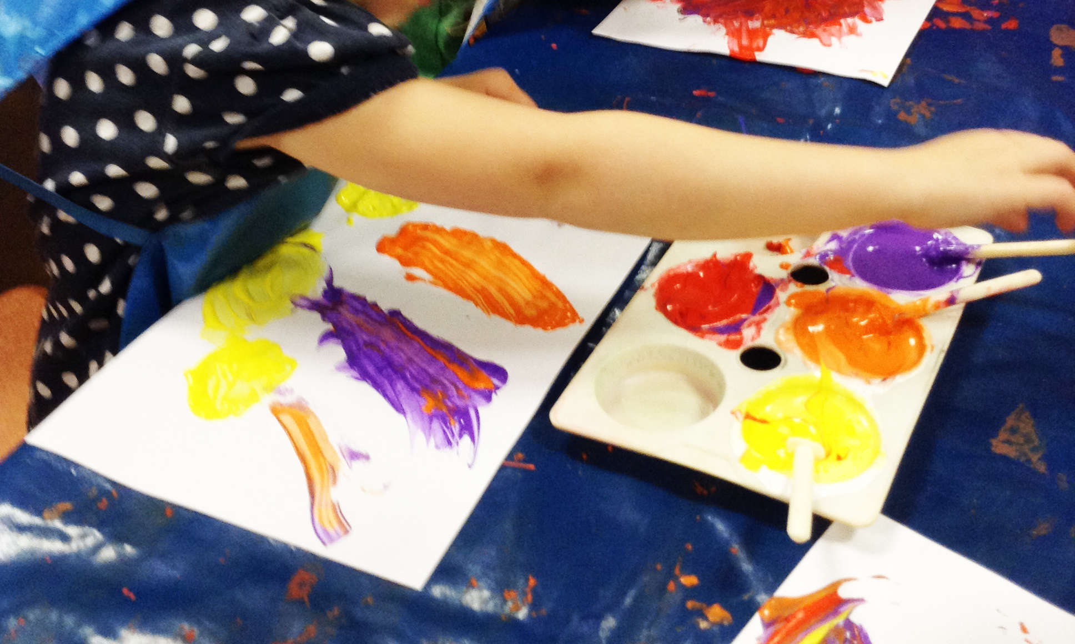
Arts & Crafts
Craft
In class we all enjoy making different craft things to be proud off. At home if you have access to craft materials, such as paint, paper, pens etc then any kind off craft work will be much enjoyed with your family. Here’s some ideas but if you have anything else in mind then please use your own ideas.
Paper plate wind catchers
Mark making with paint brushes, pens, fingers, feet….use whatever you want!
Toilet roll butterflies

Slide 18

Task 8

Slide 19
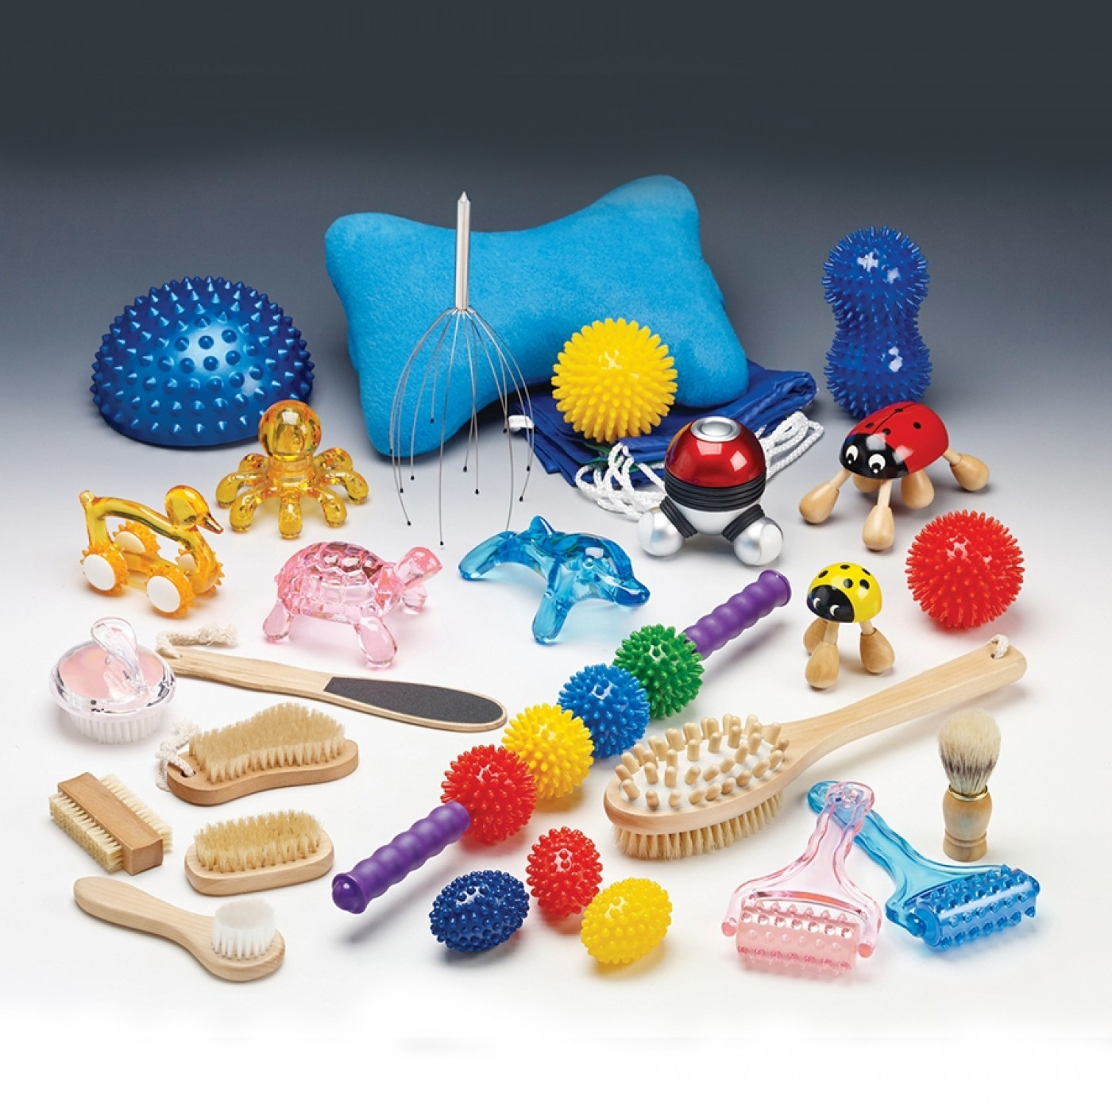
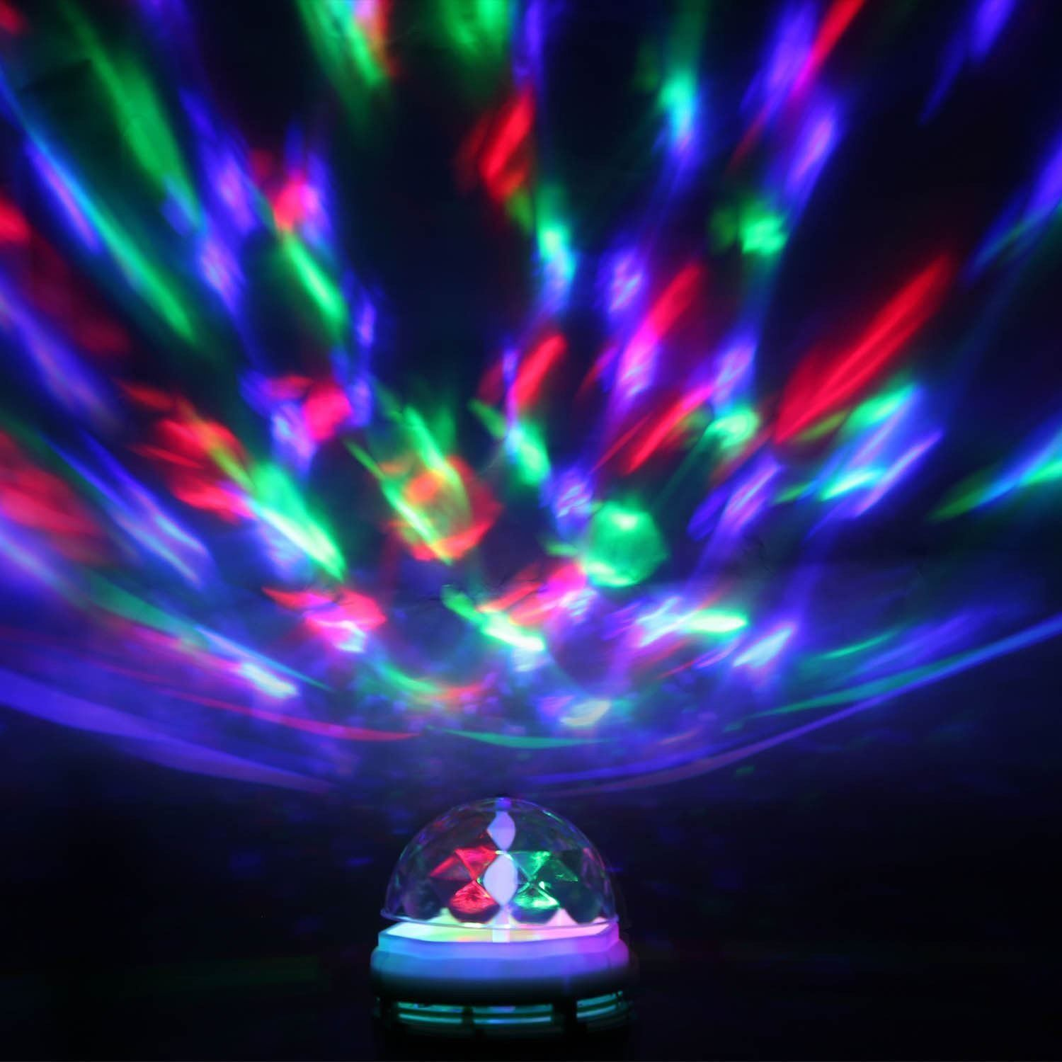
Relax!
At school we often enjoy some sensory massage time and this will be easy and simple to recreate at home.
Play some soothing/relaxing music, find some hand cream or moisturiser and then enjoy some quiet time.
If you have access to any sensory lights at home then this would be a great time to put them on and enjoy them in a dark space/room.

Slide 20

Task 9

Slide 21
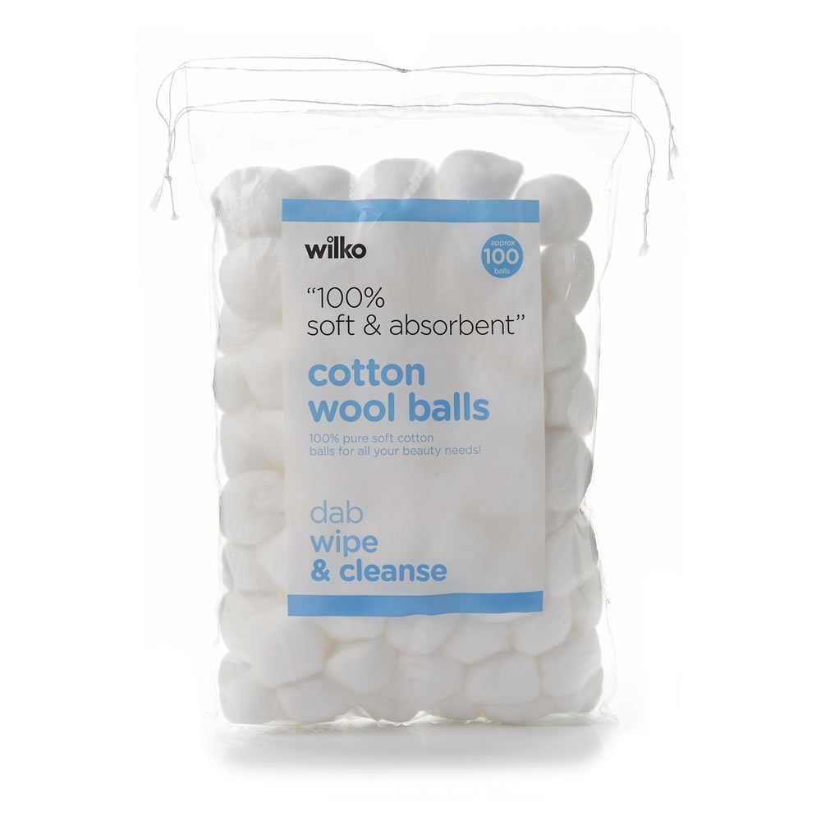
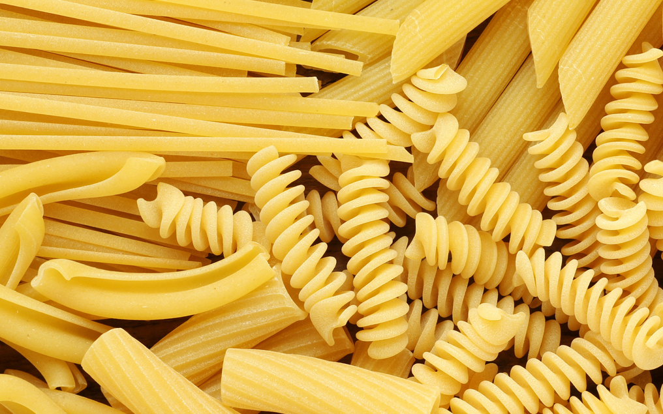

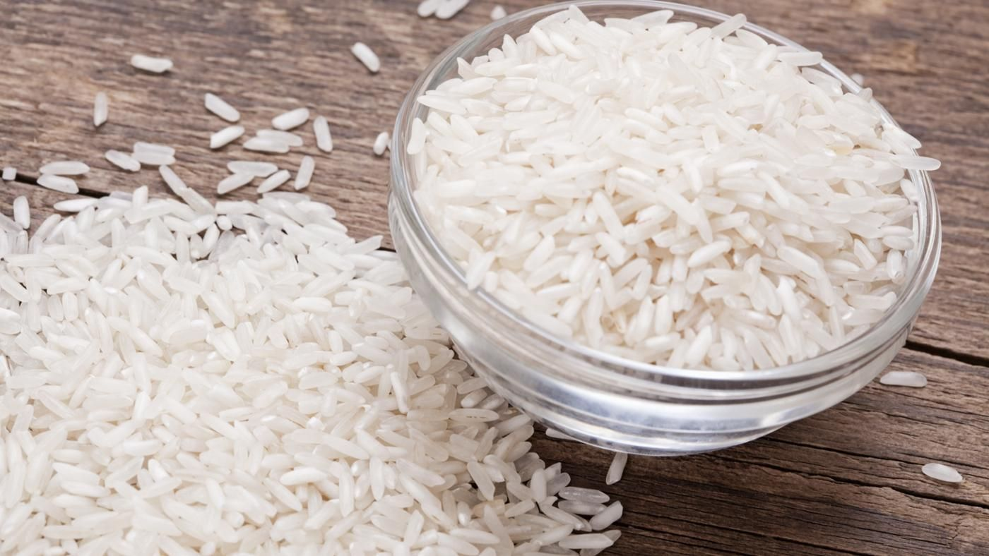
Sensory Exploration
Textures
In class we enjoy exploring lots of different and new textures as part of different activities.
Engage with different textures…
Can you touch different things in your house?
Can you explore a tray/bowl filled with different textures?
Can you pick different objects/textures up?
Can you choose which ones you like/dislike?
Can you use any textures to make something? E.g use some cotton wool in a craft activity

Slide 22

Task 10

Slide 23
Outdoor learning
If you have access to an outdoor space and it is safe to do so then enjoy being outside, get some fresh air and explore!
Some idea’s for things to do outside:
Collect things from the outdoors e.g. leaves, sticks etc – can you use them to make a collage?
Can you practice your driving? With some support from an adult at home set up some obstacles, can you drive around them?
What can you see? Look all around your garden, what can you find?
Take pictures – can you use an ipad/phone to take pictures outside?
Talk about the weather – can you choose is it ‘hot’ or ‘cold’ – If you use a VOCA can you find words to discuss the weather?
Simply enjoy being outside and enjoy a walk!

Slide 24

Task 11

Slide 25

Music
We love music activities/lessons at school so this would be a great way to have fun with all the family at home.
Do you have any instruments at home? If so, play them!
How much noise can you make?
Can you grasp onto an instrument?
Can you reach out for an instrument?
Can you independently explore/play an instrument e.g. shake a shaker?
Can you join in with singing a song?
Can you move/dance to a song/music?

Slide 26
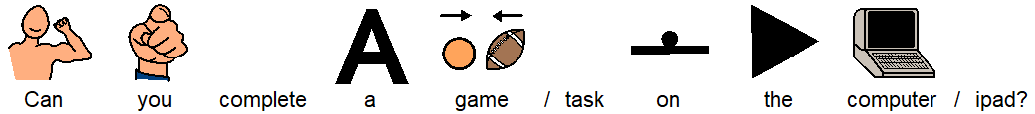
Task 12

Slide 27
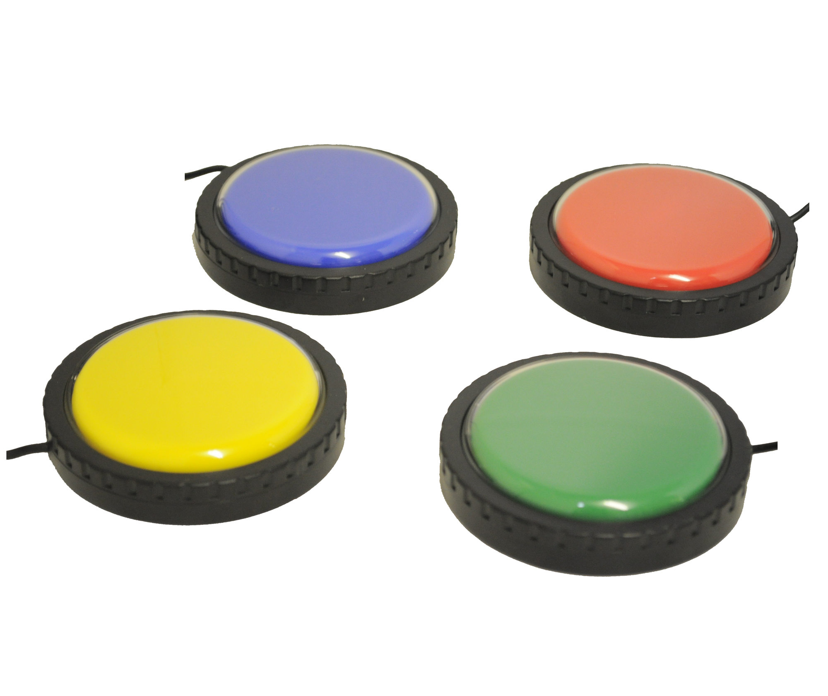
Computing
Switch work
If you have access to a switch at home then there are lots of different games and websites you can try out (a list of websites is attached).
In class the students all use different access methods to play cause an effect games.
One of our favourite websites is ‘helpkidzlearn.com’
Students are encouraged to reach out and press their switch in order to engage with the game.

Slide 28
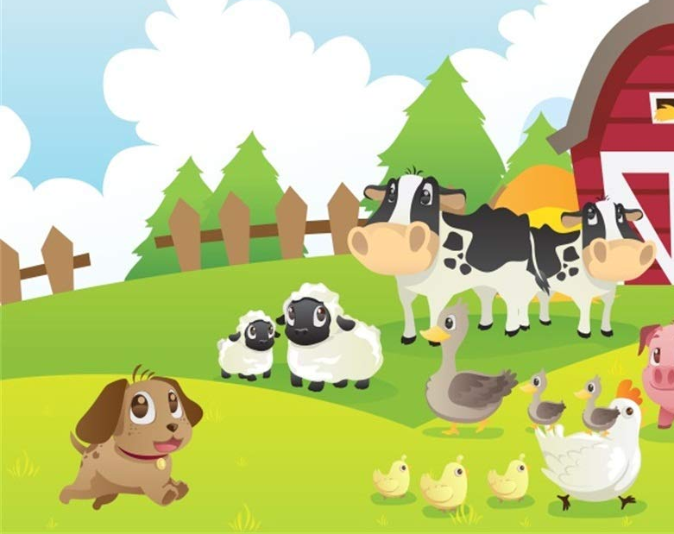

At the Farm

Slide 29
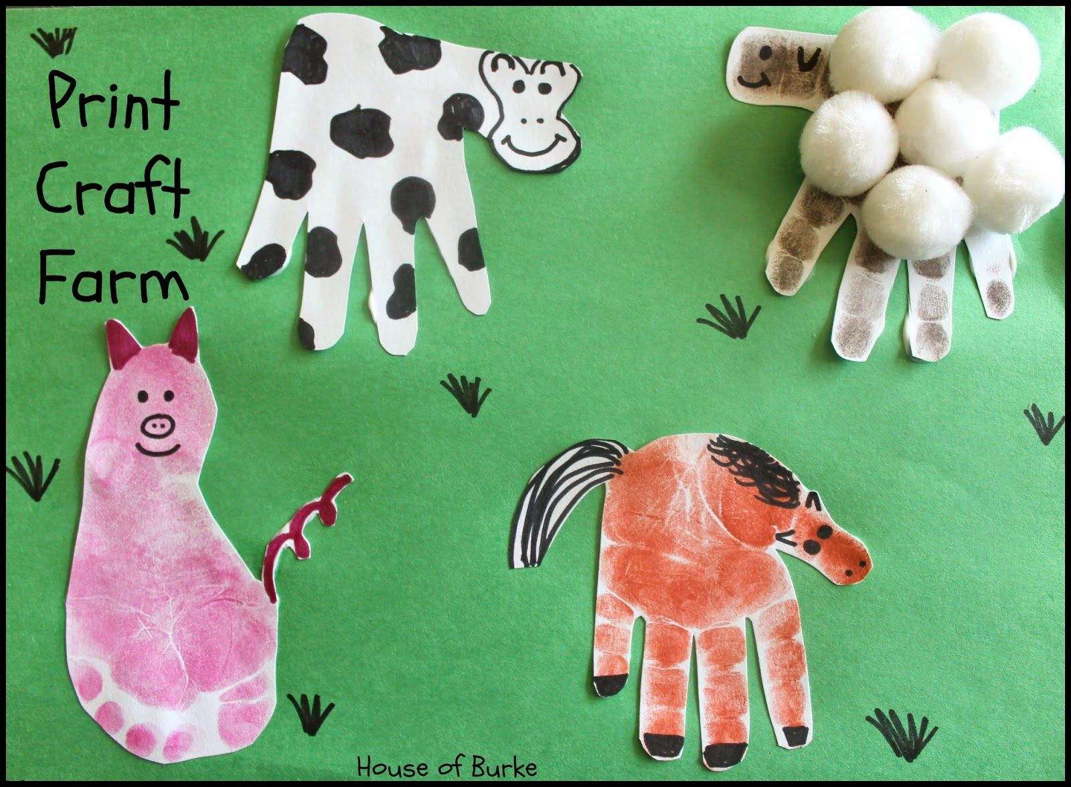
At the Farm
To continue with our term topic at home here are some ideas and short activities that you can try at home.
Sing ‘Old McDonald had a farm’ with your family – encourage signing for each animal, vocalisations and singing along. You can add different toys or objects of reference for each animal e.g. for pig you could touch some mud, for sheep you could touch some cotton wool, for duck you could splash some water etc.
Animal craft – hand print painting to create different animals.
Listen to and make animal sounds – this can be a silly but very fun activity – turn taking to be encouraged. Cognition game – play or make an animal sounds and then ask student to identify the sound.

Slide 30


Easter

Slide 31

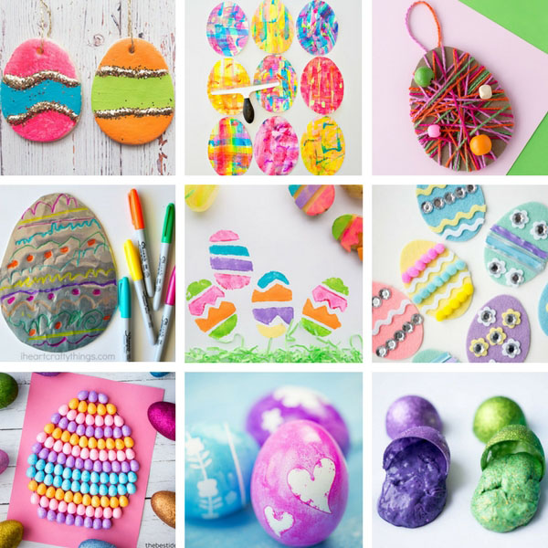
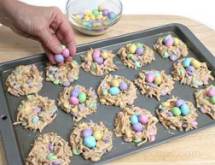
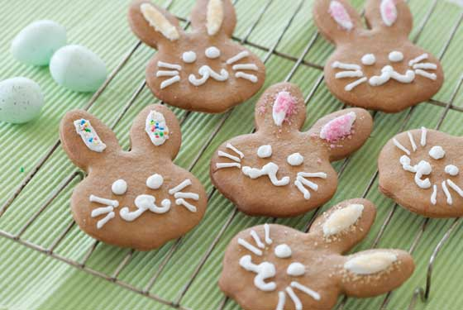
Easter
If we were at school we would be engaging with lots of activities based around the celebration of Easter. If you wish to at home here are a couple of different things you could be doing at home with your family.
Easter baking/cooking – you will be able to find a range of different recipes to follow online to enjoy at home.
Easter crafts – some simple mark making, colouring, painting etc or make an Easter card.
Easter egg hunt – either with real eggs or pictures (last year at school we hid pictures of eggs, as the students found them thy had a task to complete which was on the back of the egg, e.g. can you touch your nose).
Listening to/reading an Easter story.

