Slide 1

Year 2
Introduction Evening
September 2025

Slide 2

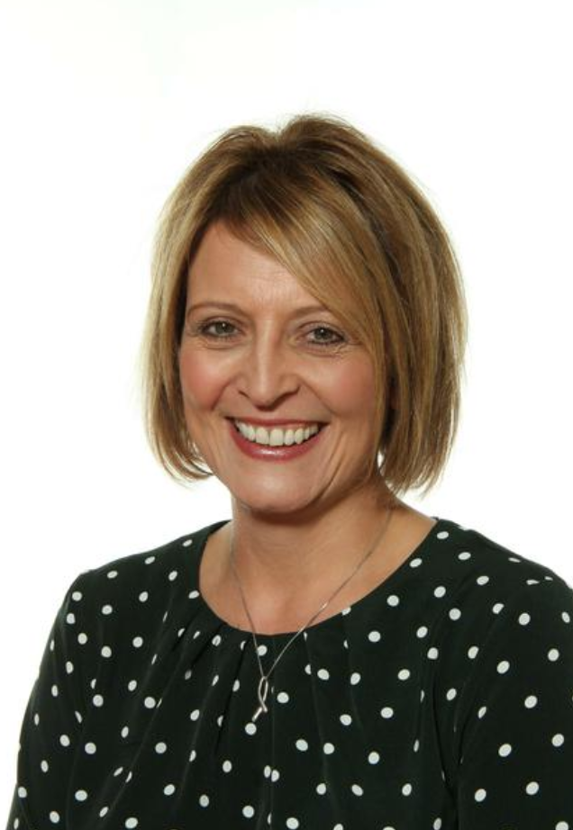
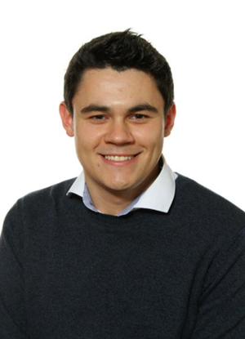
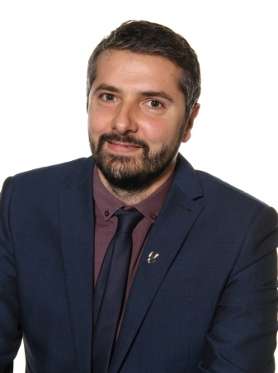
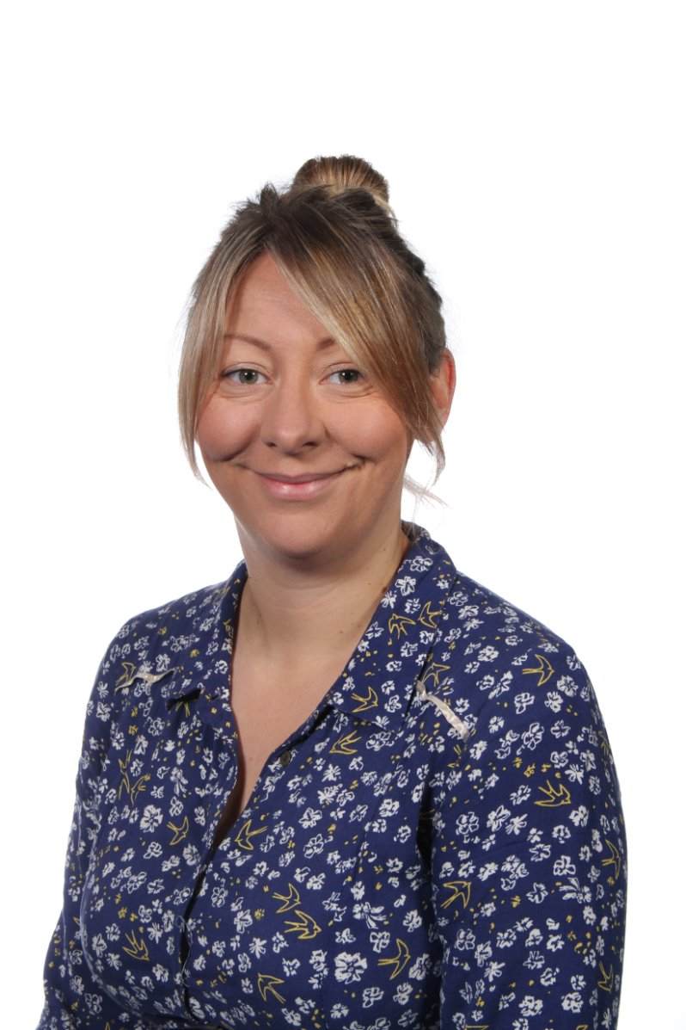
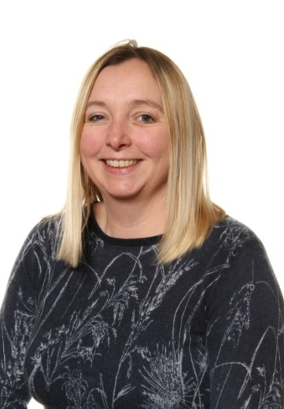
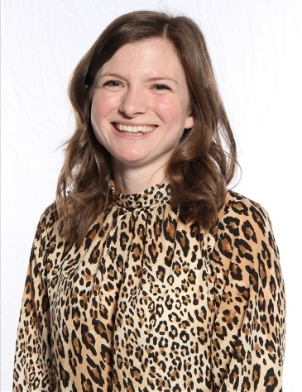
Staffing
The Senior Leadership Team includes:
Sarah Sheepy
Executive Headteacher
Nick Williams
Head of School
Orlando Graña
Deputy Head
Kerry Pope
Deputy Head and DSL
Marianne Halford
Y1/2 Phase Leader
Liz Munday
SENDCo
Notes:
Maz

Slide 3

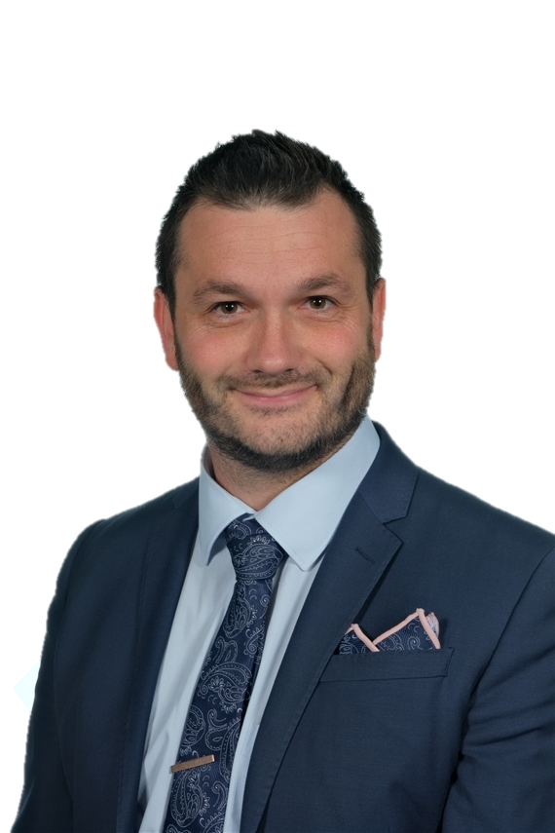
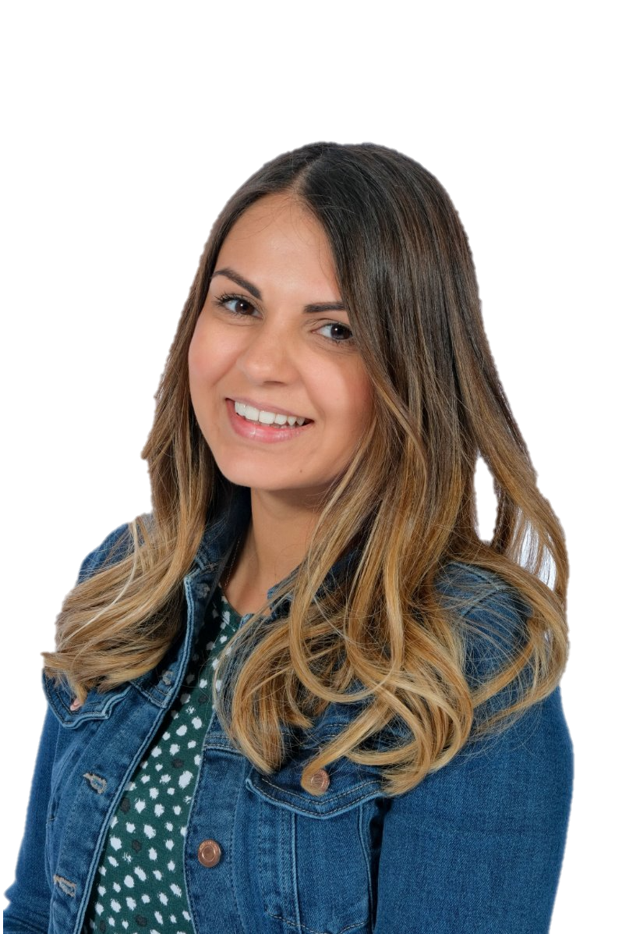
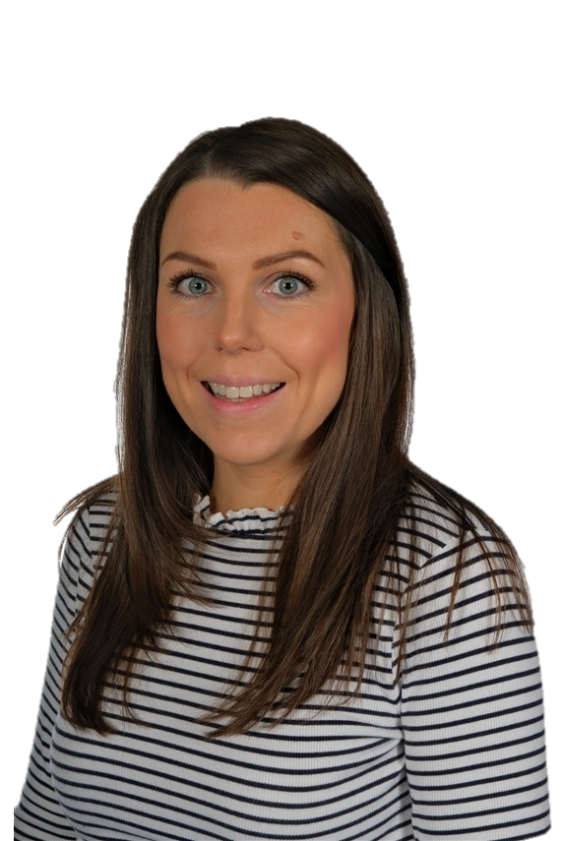
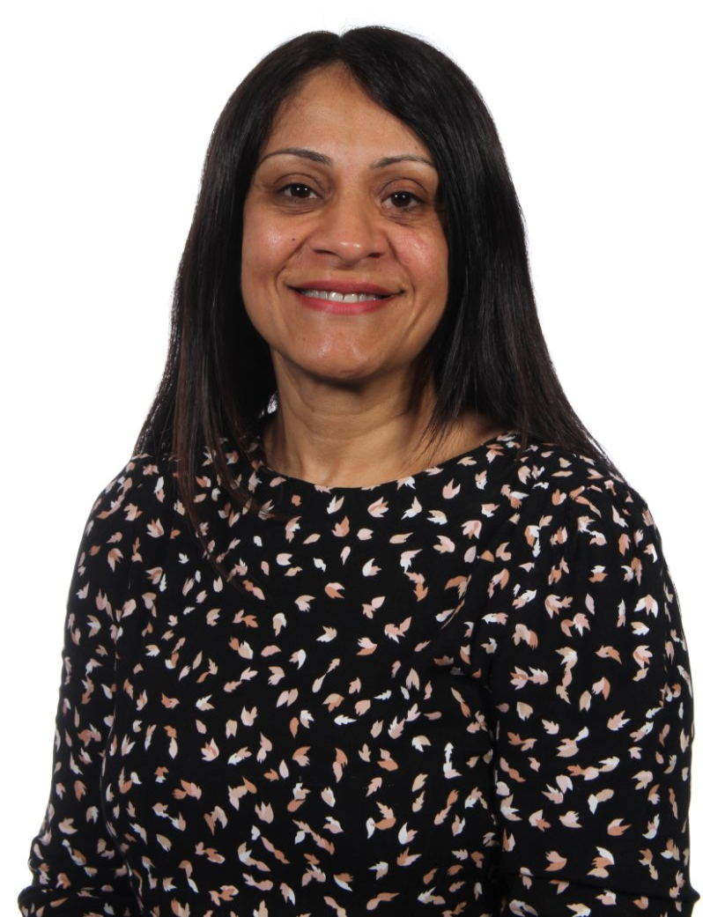
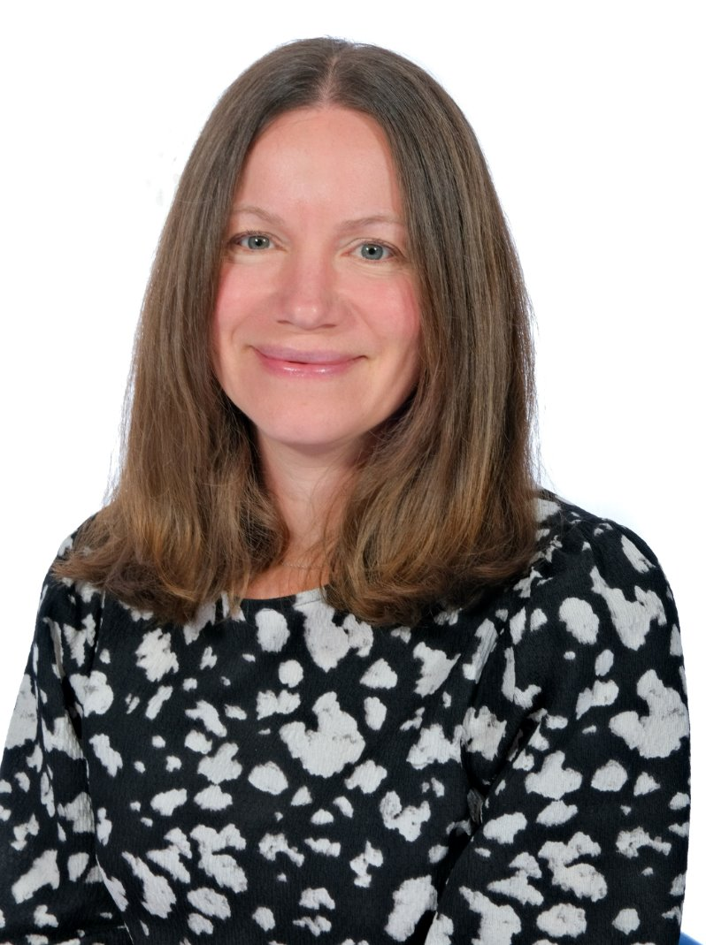
Staffing
The class teachers in Year 2 are:
Marianne Halford
2HH
Becca
Hawkins
2HH
Craig
Rose
2CR
Charley
Slater
2CS
The teaching assistants in Year 2 are:
Ekjyot
Bhambra
2HH
Susan
Bagri
2CR
Jess
Heatley
2CS
Notes:
Maz

Slide 4





Year 2: Curriculum
The children experience a varied curriculum at Coten End.
An overview of the year’s curriculum content can be found on the website.
The learning themes in Year 2 are:
AUTUMN
SPRING
SUMMER
Awesome Africa
Fireworks and Flames
Blue Planet
The Victorians
Fantastic Mr Fox
Castle Quest
Geography
Art
History
RE
Cookery
Art
Geography
RE
Art
History
DT
RE
Geography
History
DT
Notes:
Overview of curriculum – explain that a full whole school overview is available on the website. Maz
Please be brief. No need to talk through each topic.

Slide 5

Year 2: COOL Curriculum
Choosing Our Own Learning
C – Choice
O – Ourselves
O – Ownership
L – Learning and Links
As a school we are working on building on the success of the continuous provision framework; bespoke to our school and children.
Our intent is to create more independent and engaged learners.
Notes:
Maz

Slide 6
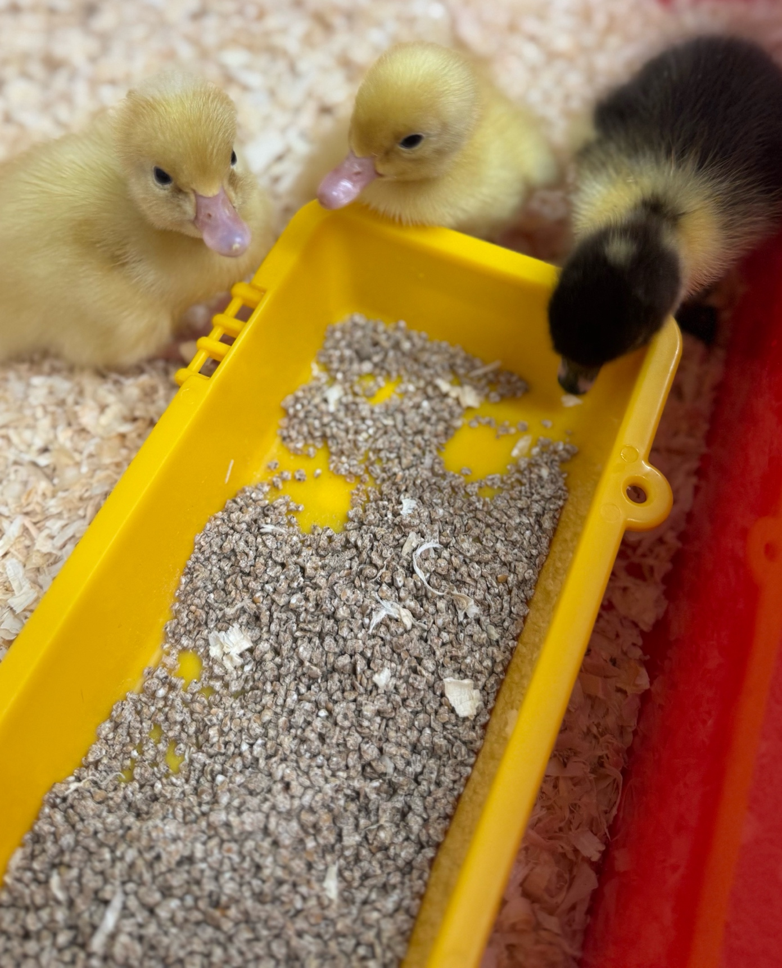

Year 2: Curriculum Enrichment
Children take part in a range of curriculum enrichment experiences throughout the year.
In Year 2, curriculum enrichment includes:
Warwick Fire Walk
Christmas Theatre Trip
Christmas Performance
Geography Fieldwork at St Nick’s
Victorian Theme Day
Chicks and Ducks
Castle Theme Day
Warwick Castle trip
Notes:
Give an idea of the trips planned and any other curriculum enrichment days e.g. topic days – what costumes may parents need to prepare for? Charley

Slide 7





Year 2: Key Texts
During lessons, the children will have opportunities to read and explore a wide variety of rich literary texts, including:
AUTUMN
SPRING
SUMMER
Awesome Africa
Fireworks and Flames
Blue Planet
The Victorians
Fantastic Mr Fox
Castle Quest
The Lion Inside
Rachel Bright
Giraffes Can’t Dance
Giles Andreae
Molly McDrew and the Great Fire of London
Naomi Joselyn
Tiddler
Julia Donaldson
Somebody Swallowed Stanley
Sarah Roberts
TBC
Fantastic Mr Fox
Roald Dahl
Zog
Julia Donaldson
Notes:
Highlight key texts from the long term overview. Charley

Slide 8
End of Year 2 Expectations
We have created a pack of useful information that will be uploaded to Google Classroom and the website:
Maths Key Skills
Maths Calculation Methods* Parents Information Evening
English Key Skills
Sound Mat
Reading Comprehension Prompts
Common Exception Words
Reading Recommendations
Come and Learn sessions will take place through the year.
Notes:
Craig

Slide 9
Year 2: Homework
Homework will be set on Google Classroom on Thursday and handed in on Monday
Work should be completed in pencil using the book provided – homework does not need to be printed
There will be an alternate of Maths, English and Reading exercises.
A spelling activity, with a focus on a spelling rule, will also be uploaded – there will be no weekly spelling test
Times Table Rock Stars will become available in the Spring term
Please speak to us if you have any issues accessing or completing homework
10 minutes of reading should be completed a minimum of 3 times per week.
Notes:
No change to homework just make it right for your year group and show. Becca

Slide 10

Reading
Although most children completed the phonics screening check in Year 1, it is still vital sounds are recapped regularly at home​
Those who didn’t take or pass the screening check in Year 1 will complete the check at the end of Year 2​
All children will be assessed on their reading level at the start of the Autumn term – they may move up or down levels​
Reading will move to a focus on comprehension, including retrieval skills​
Children should be aiming to read 3 or more times per week at home – reading diaries will be checked weekly
Reading diaries are purely used to keep a record of reading – any messages must be communicated directly to class teachers
Class Libraries
Love of reading
Regular reading at home
Sharing texts
Notes:
I have put this after homework so that we can really emphasise that this is the most important homework. Becca

Slide 11
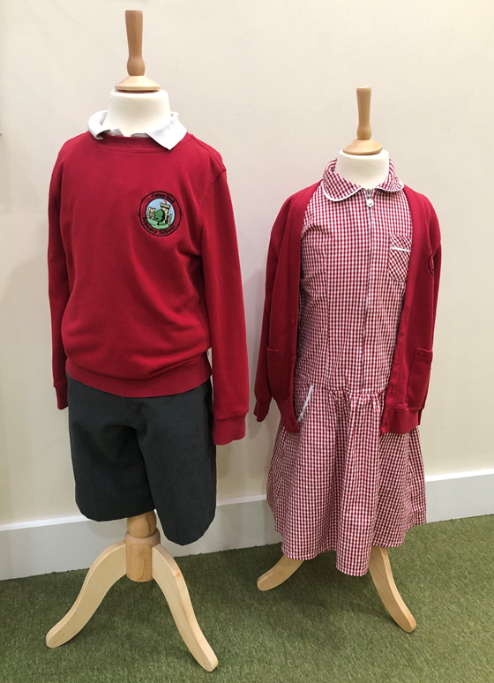
Uniform
• Grey or black trousers
• Pinafore dress or skirt
• Grey or black trousers or shorts
• Red or white polo shirt
• Red sweatshirt or jumper or cardigan
• Red and white summer dress
• Grey or white socks
• Grey, white or red tights
• Black shoes (trainers, Vans, Dr Marten-style boots, and sandals are not suitable)
•A pair of wellies
• A suitable coat for all weathers (any colour) – a hoodie is not an acceptable alternative for a coat.
Notes:
NO CHANGE – simply show Becca

Slide 12
PE Kit
Children to have PE kit in school and will change into this on their PE days.
PE kit will be sent home regularly for washing.
There should be no branded logos/designs on any of the PE clothing nor should children wear any football kit.
If these are brought to school for PE, the children will be asked to take them home again and will be given spare PE kit to wear for the lesson that day.
The following PE kit may be worn:
Red or white round necked t-shirt
Black PE shorts or skort
Black or navy blue jogging bottoms
Black or navy blue tracksuit top or sweatshirt (not a hoodie)
Black pumps/plimsolls for indoor PE
Trainers for outdoor PE (Years 1-6)
Notes:
NO CHANGE – just show Becca

Slide 13
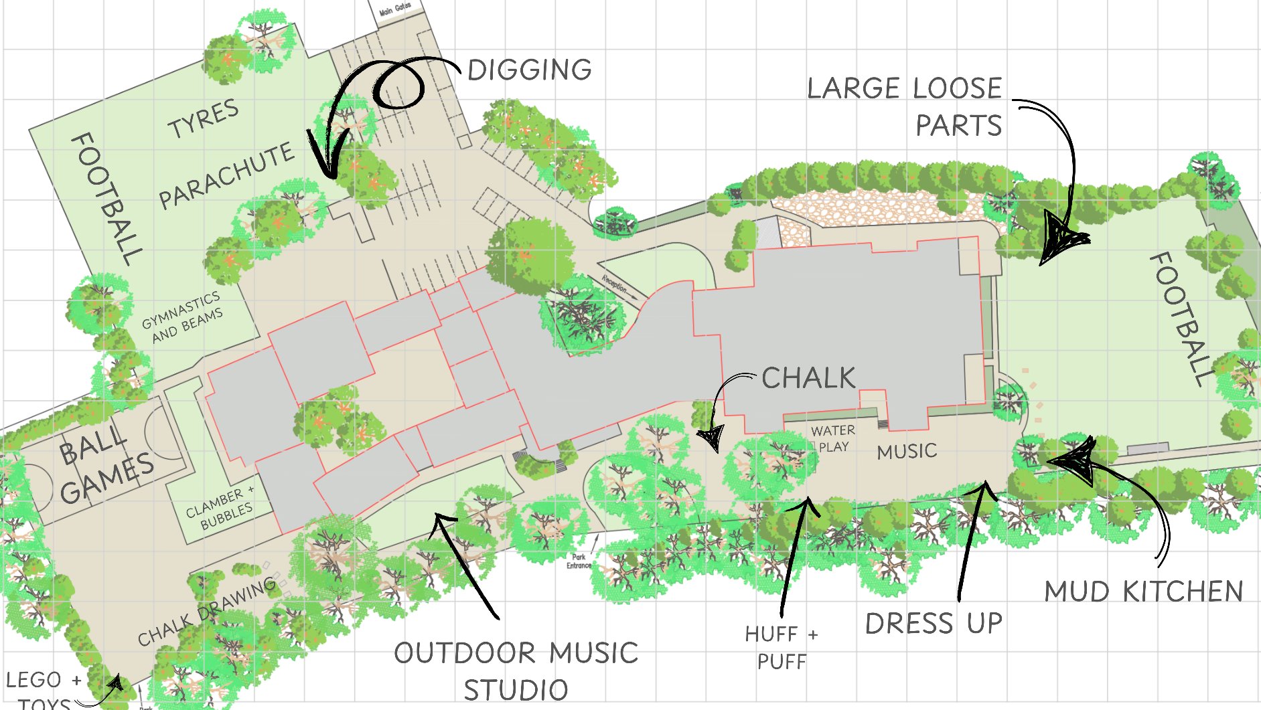
OPAL (Outdoor Play and Learning)
We have come very far with our play offer over the last 18 months.
We have lots of wellys left behind from last year as donations so please do take a pair – most were not used that often and they just need a bit of a clean.
Wet weather gear! Optional, but if your child has got waterproof trousers as well as a waterproof coat, they are welcome to bring them in.
Children must have wellies in school.
Y5/6 may choose to bring in high-ankle walking boots if they prefer
Notes:
OPAL Maz

Slide 14
Relationships and Behaviour
At Coten End, we aim to create a happy, safe, caring, stimulating and inclusive environment for all. Our vision is that everyone at Coten End is valued, treated with respect and fulfils their potential - through an ambitious and inclusive curriculum.
BE RESPECTFUL
BE SAFE
The school’s rules, in red, have been successfully embedded, over the last 2 years – through the school’s Relationships and Behaviour Policy; the policy can be found on the school website.
Positive behaviours are encouraged by all staff.
Praise is given regularly and attributed to specific behaviours (e.g. ‘Thank you for listening and showing respect, whilst I am talking.’)
Some low-level behaviours are purposefully ignored – staff ‘positively notice’ and choose to highlight positive behaviours (in an attempt for these to be copied by others) so negative attention is avoided, where possible.
Staff are constant role models - offering stability, by being measured and consistent, to create a calm, safe and supportive environment.
Notes:
Continuation of our implementation of the relationships and behaviour policy. Maz
Highlight praise/positive noticing and how we reward children.
Highlight natural consequences. Give examples: A natural consequence for unsafe play at playtime may be to lose some of their playtime. A natural consequence for not completing work through lack of effort may be to catch up in their own time.

Slide 15






Relationships and Behaviour
The school’s values, above, continue to play an integral role in promoting positive behaviour choices in school. They are referred to when offering praise; children are rewarded with stickers and certificates related to the values – and the values are directly referenced when having restorative conversations with children.
The school’s restorative approach encourages pupils to take responsibility for their actions and understand the consequences of their behaviour on others. ‘Repair’ may be through actions or an apology (sometimes this is supported/facilitated by an adult).
As well as the relationships that staff build with children, the relationship between teachers and parents/carers is equally as important and is reciprocal in nature. Just as parents/carers may look to the school for support, the school may also reach out to parents. Having an open relationship, where any issue can be discussed, is key to a successful year.
Hierarchy, related to role in school, is not used. All staff offer the same consistent messages to children – so that children know that all staff have the same expectations of behaviour and that behaviour choices are dealt with in the same way.
The use of ‘Zones of Regulation’, and other self-regulation strategies, are explicitly discussed with children to help children regulate their emotions (with the support from adults), so they are ready to learn.
Notes:
Continuation of our implementation of the relationships and behaviour policy. Maz
Highlight praise/positive noticing and how we reward children.
Highlight natural consequences. Give examples: A natural consequence for unsafe play at playtime may be to lose some of their playtime. A natural consequence for not completing work through lack of effort may be to catch up in their own time.

Slide 16

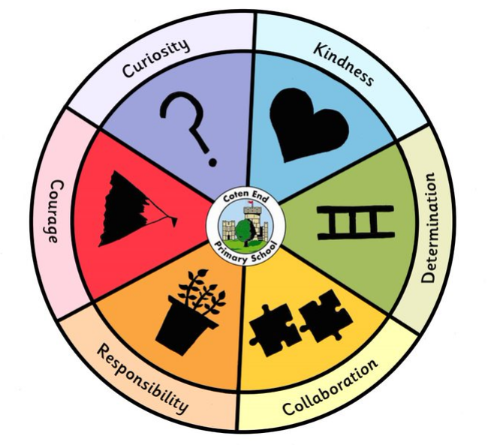
Awards
Values Awards and two Achievement Awards will be presented each week in assembly
Year 2 Celebration Assembly will take place on Wednesday at 9:05am in LSH
Mathematician and Writer of the Week will be presented in the school corridor via the office weekly
Notes:
Please specify when information will be communicated. Maz

Slide 17



Attendance
We are committed to working in partnership with families to achieve the best possible attendance for your child.
Set high expectations regarding your child’s attendance at school
Absence from school affects your child’s progress both academically and socially
Target of no more than three days absence per academic year
Avoid absence from school where possible
Contact the school office each day before 9.30am either by email, telephone or via the app
DO NOT take family holidays during term time – risk of penalty notice > 10 days consecutive absence
Avoid GP and dental appointments during school hours
If your child is reluctant to come to school, share any concerns with the appropriate member of school staff to seek support at the earliest opportunity
See the Attendance policy which can be found on the school website
Attendance Lead –Kerry Pope Parent Support Advisor – Nicky Pittaway
Coughs and colds don’t usually mean a child needs to be kept at home. We can keep their medicine e.g., Calpol in the school office and administer it, with your permission, to help them through their day.
Notes:
Craig

Slide 18
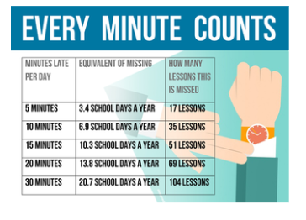
Lateness and Punctuality
We are aware that consistent lateness can have an affect on a child's entitlement to education.
As a school we have clear expectations that children should be in on time, each day. When appropriate, parents/carers will receive half termly information when the school is concerned about your child's lateness.
-School doors open at 8.40am and close at 8.50am.
-Any child who arrives after 8.50am will need to do so through the schools main office.
-Children who are late must sign in through the schools system with a reason, accompanied by a parent.
-All late episodes are recorded on the schools registration system along with the minutes absent, past 8.50am.
-Each week the Attendance Support Team will monitor those children who are late and record any patterns of punctuality concerns.
-If necessary, parents/carers will be contacted to discuss their child's punctuality.
-When there are consistent punctuality concerns or patterns, it may result in further conversations with a member of the Attendance Support Team. This could result in a meeting and a support plan to be implemented.
Notes:
Craig

Slide 19

Communication
Ways in which communication is shared:
School App - MCAS (mychildatschool.com): communication from school office, lunch orders and payments, trip payments, absence notifications – essential, please enable push notifications
School website: newsletters every fortnight, class blogs, knowledge organisers
Google Classroom: homework, knowledge organisers
Please update us of any changes of address, phone number, medical needs as a matter of urgency.
Notes:
School App – it is essential parents have this as we will not be emailing messages en masse – direct to office if issues with this

Slide 20
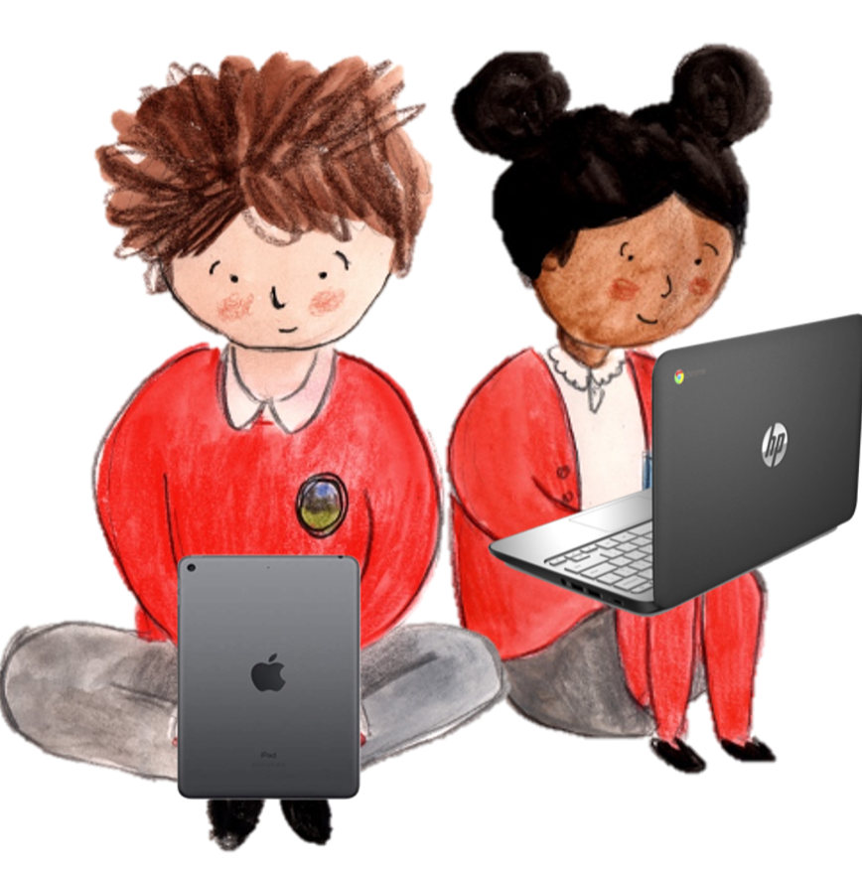
Online Safety
At Coten End, we provide children with an effective, reactive Online Safety curriculum through, but not limited to, our Computing, PSHE and RHSE lessons.
At school:
We encourage children to consider what positive, healthy and respectful online relationships looks like.
How to use technology safely and how/where they can seek support and advice.
Our online safety programme is regularly revisited – this includes relevant and up to date messages about internet usage, video gaming and apps we are made aware of.
Key online safety messages will be reinforced during assemblies and activities annually on World Safer Internet Day.
Pupils are taught to be critically aware of the materials/content they access online and be guided to validate the accuracy of information – including the use of AI.
The key online safety themes explored within our curriculum include:
1. Self-image and identity
2. Online relationships
3. Online reputation
4. Online bullying
5. Managing online information
6. Health, Well-Being and Lifestyle
7. Privacy and security
8. Copyright and ownership
Children are encouraged to have open and honest conversations about their activity online.
If school staff have any concerns surrounding a child’s online activity, they have a duty to report it as a safeguarding concern.
Notes:
Charley.

Slide 21








Online Safety
There has been a noticeable rise in how technology use at home can affect children within school. We regularly see stress, anxiety and mental health issues linked to use of social media, video apps and gaming.
Screen Time:
Excessive screen time in children can potentially lead to dopamine-related issues, similar to addiction, impacting focus, motivation and emotional regulation. The rapid rewards offered by digital platforms can overwhelm the developing brain, making it harder for children to self-regulate and find pleasure in other activities.
Screens release dopamine, a ’feel-good’ neurotransmitter and hormone, associated with pleasure and reward. The brain develops a tolerance to dopamine, cause children to crave more screen time to achieve this ‘feel-good’ effect. If screen time is reduced or stopped, withdrawal-like symptoms such as irritability, restlessness and difficulty concentrating may occur.
Social Media:
Online games, social media and video chat programs provide opportunities for children to connect and play with their friends, parents and relatives. However, most social media sites and apps have age restrictions due to older content that could be accessed and for which children below that age are not prepared for.
13+
13+
13+
12+
13+
13+
18+
Check age recommendations
Notes:
Charley

Slide 22
Online Safety
The most impactful online safety comes from home:
Have an open and honest dialogue around use of technology – it is important as parents and educators that we react calmly to incidents – we want children to feel safe, not scared.
Have a balance in screen time – create boundaries and rules together.
Enable content filters on devices, including gaming consoles.
Use child-friendly versions of apps/websites e.g. YouTube Kids – be aware of age ratings!
Regularly check messages and internet usage.
Model healthy internet usage - consider tech-free zones in your household e.g. no bedrooms.
Turn off screens at least 30 minutes – 1 hour before bed.
Notes:
Charley

Slide 23
Online Safety
Further Support:
Websites with further information for parents, carers and young people:
  www.saferinternet.org.uk
  www.commonsensemedia.org
  www.thinkuknow.co.uk
  www.net-aware.org.uk
  www.internetmatters.org
  www.childnet.com
  www.nspcc.org.uk/keeping-children-safe/online-safety
  https://nationalcollege.com/experts/national-online-safety
Check age ratings:
  www.bbfc.co.uk - films
  https://pegi.info/page/pegi-age-ratings - games
Notes:
Charley

Slide 24

Pupil Premium
If your child is eligible for Free School Meals, they are also entitled to a range of support in school funded by the Pupil Premium Grant.
This includes access to additional learning and extra-curricular opportunities, academic support, financial support for school trips and a fully funded music lesson or sports club.
Even if children are only eligible for Free School Meals for a short time, they continue to receive Pupil Premium funding for 6 years.
You can find out if your family is eligible on the Warwickshire County Council website: https://www.warwickshire.gov.uk/education-learning/apply-free-school-meals
Notes:
Maz

Slide 25
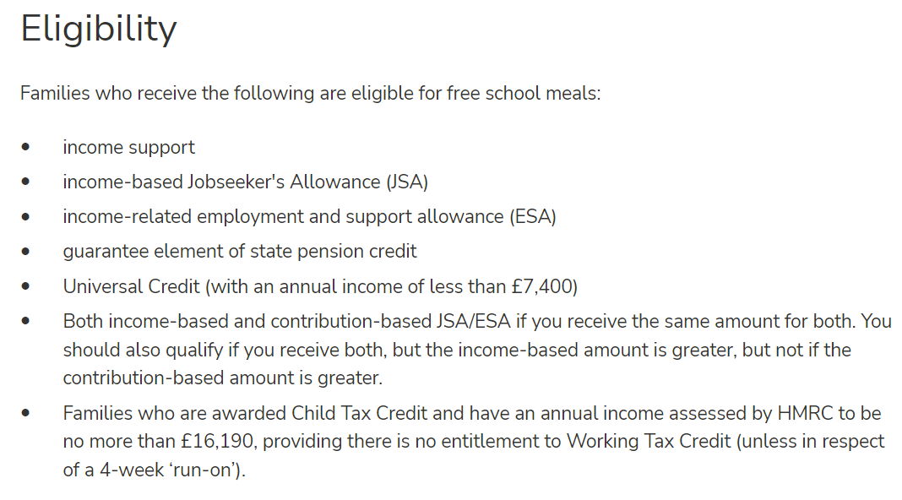
Pupil Premium
To apply for free school meals, visit:
https://www.warwickshire.gov.uk/education-learning/apply-free-school-meals
Notes:
Maz

Slide 26
Questions?
Please speak to your child’s class teacher individually if you would prefer.

